Slide 1
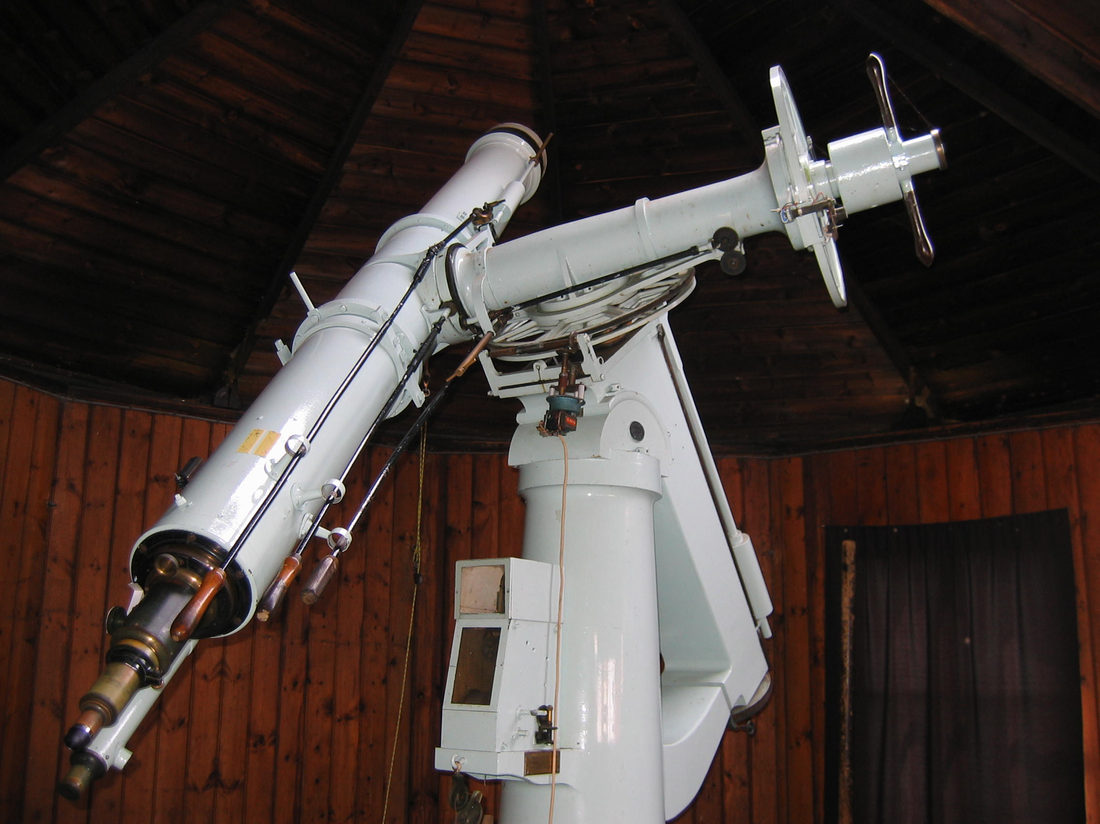
The life history of a
double star telescope
Bob Argyle

Slide 2
Brief resumé of talk
Double and binary stars
The maker: Thomas Cooke
The telescope
The first user: William Rutter Dawes
The telescope moves on: George Hunt, William Maw, W. J. Thorrowgood
Coming to Cambridge
The current observing programme
Results; measurement accuracy
Publication and current amateur journals

Slide 3
Binary stars
Gravitationally connected
Multiple stars and hierarchies
Majority of nearby stars are in double or multiple
systems
Periods range from 5 minutes to millions of years
‘Visual’ binaries are usually separated by less
than 5 seconds of arc

Slide 4
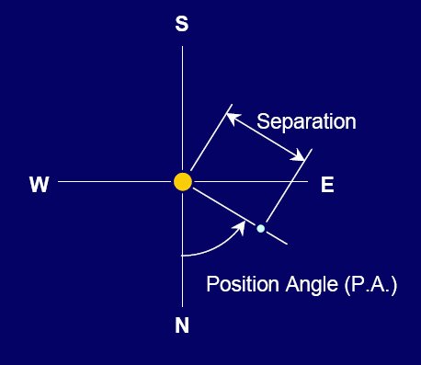

Slide 5
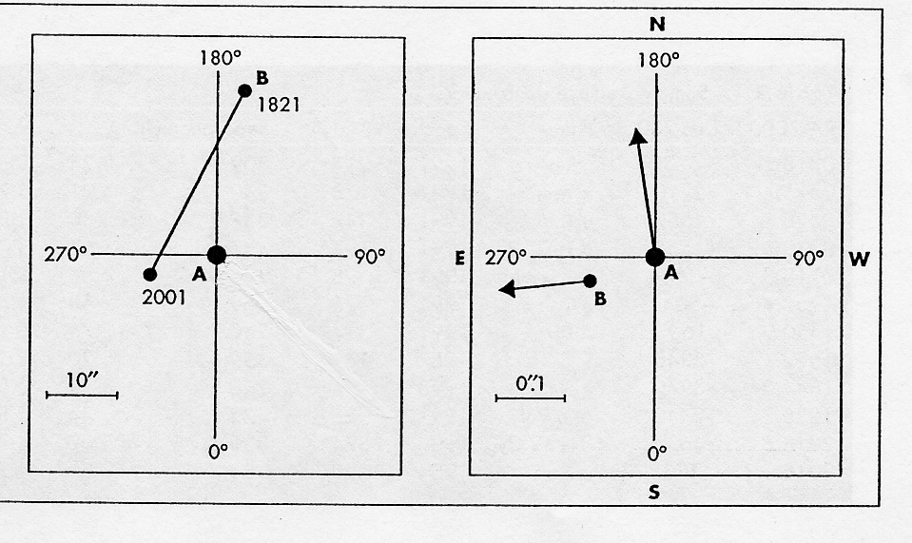
Optical pairs and binary stars
Optical pairs – a chance alignment
Examples delta Herculis

Slide 6
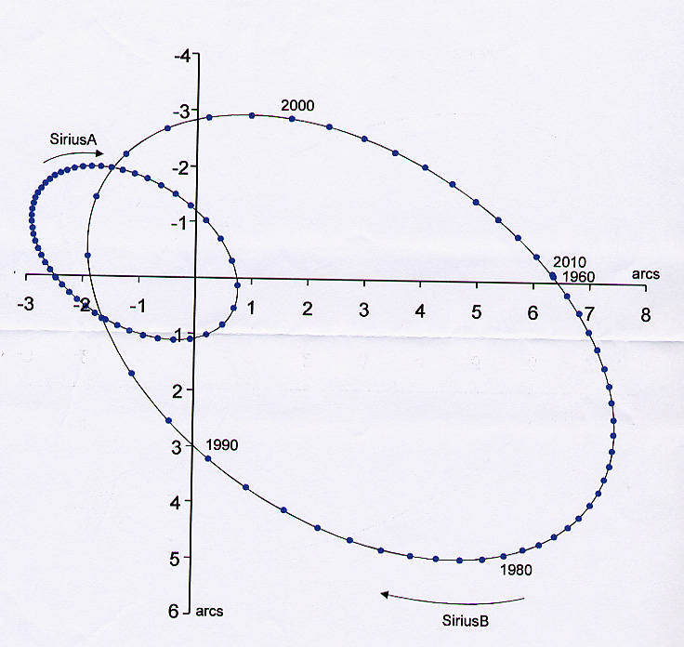
Orbits of Sirius A and B

Slide 7
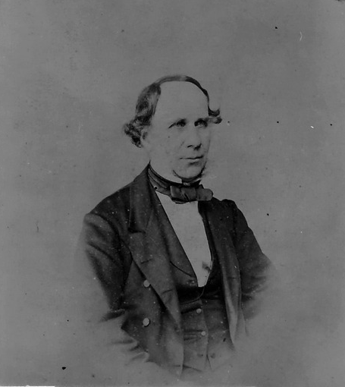
Thomas Cooke 1807 - 1868
Set up business in York in 1837
Built a number of refractors up to 15-inch (and exceptionally 25-inch)
Also built turret clocks and a 3 wheeled steam driven car
Asked by Dawes to build an 8-inch in 1863
Delivered the OG personally in Oct 1864

Slide 8
Thorrowgood telescope
Built York, England in 1864
Aperture: 8-inches (20-cm)
Focal length: 114 inches (2900-cm) = f/14
New objective fitted 1865
Weight-driven clock drive
Little used by Dawes before his death (1868)

Slide 9
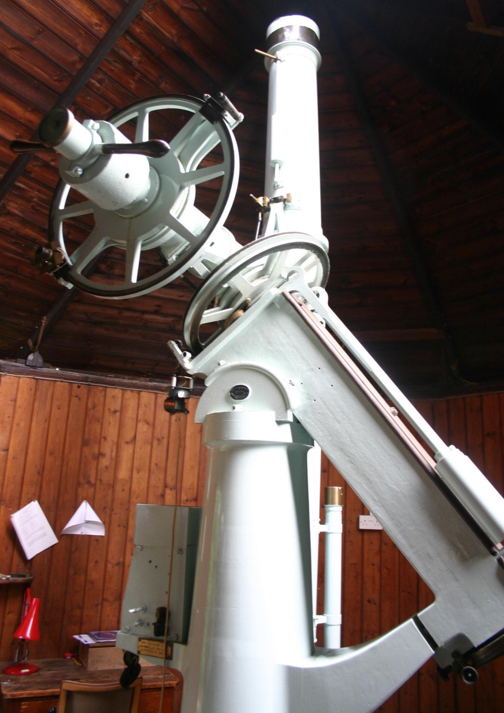

Slide 10
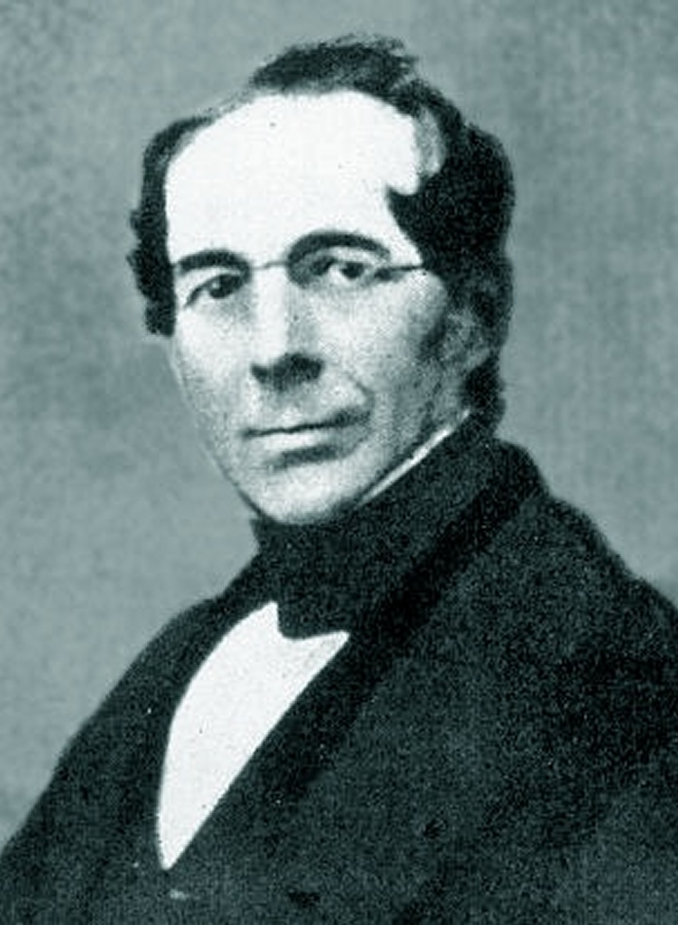
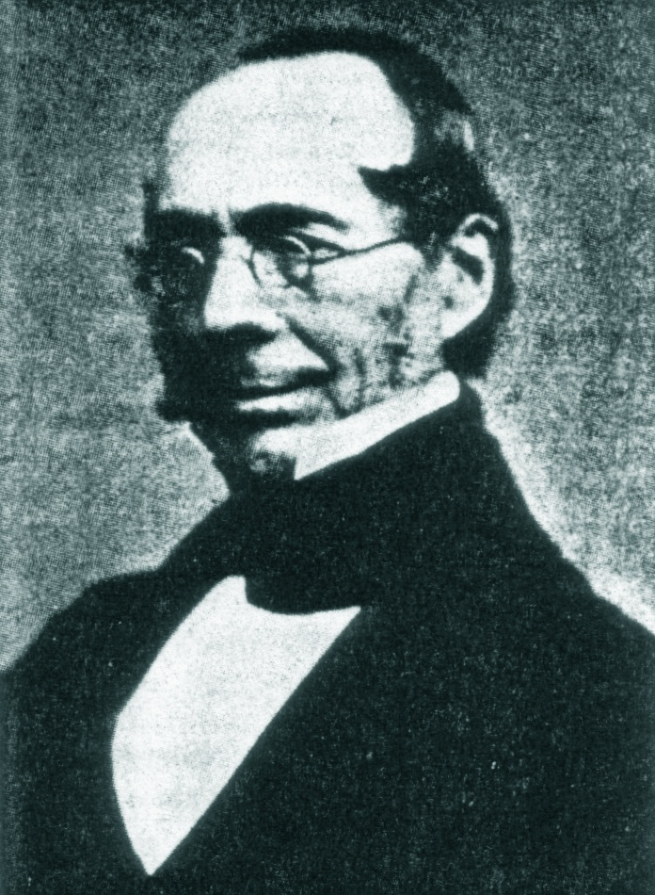
William Rutter Dawes (1799-1868)

Slide 11
W. R. Dawes - 1
Trained as a physician at St Barts, London
Moved to Liverpool in 1826, met William Lassell and became interested in astronomy
Observer at George Bishop’s observatory (1839 – 1844)
Co-discovered the Crêpe Ring of Saturn (with Bond)
Received Gold Medal of RAS in 1855 for his work on
double stars

Slide 12
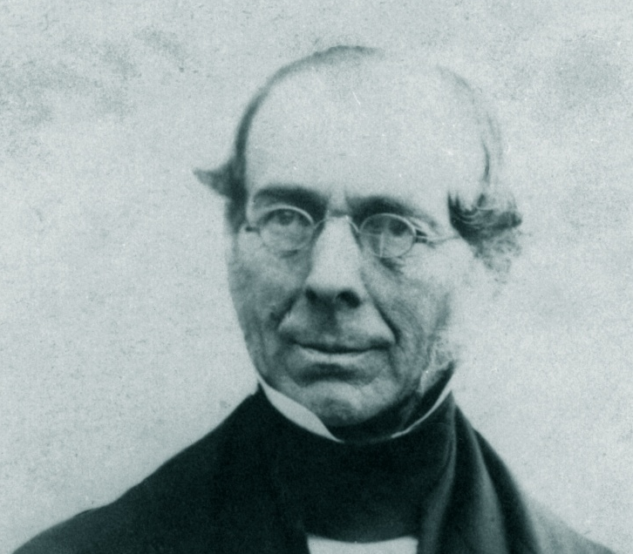
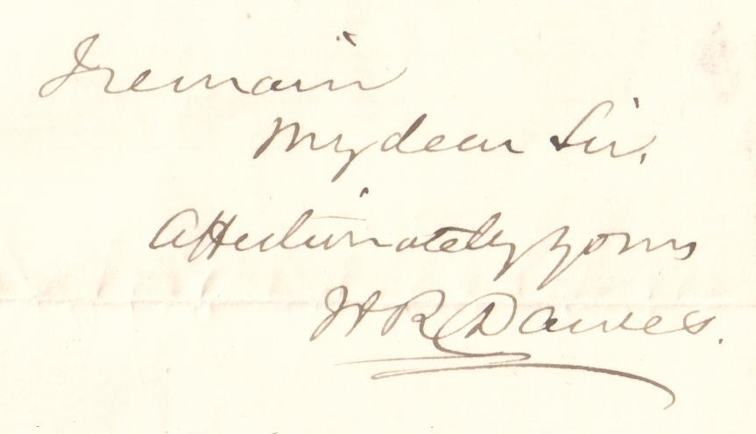

Slide 13
Airy’s Gold Medal address 1855
``Distinguished as Mr Dawes has been by an extraordinary acuteness of vision, and by a habitual, and (as I may say) contemplative precision in the use of his instruments, his observations have commanded a degree of respect which has not often been obtained by the productions of larger instruments”

Slide 14
W. R. Dawes - 2
Moved to Haddenham (Bucks) in 1857
Bought the telescope from Cooke in 1864
Rarely used it before his death
Derived the Dawes Limit (4”.56/d) which applied to equally bright double stars in a small refractor
Completed his catalogue of double star measures just before his death

Slide 15
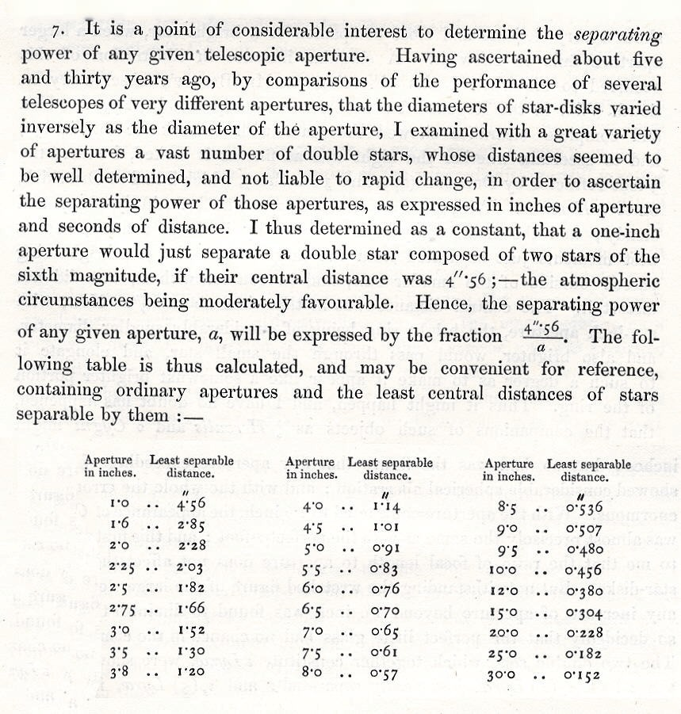
Derivation of the Dawes Limit QJRAS 1867

Slide 16
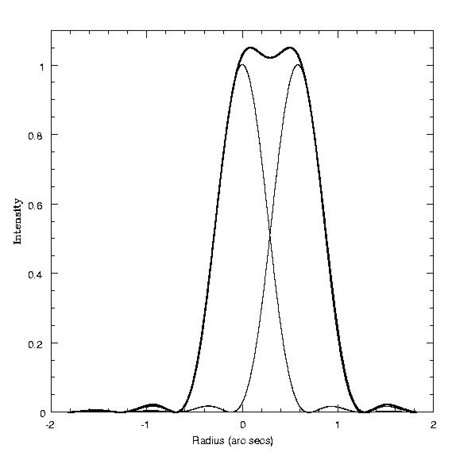
Dawes limit

Slide 17
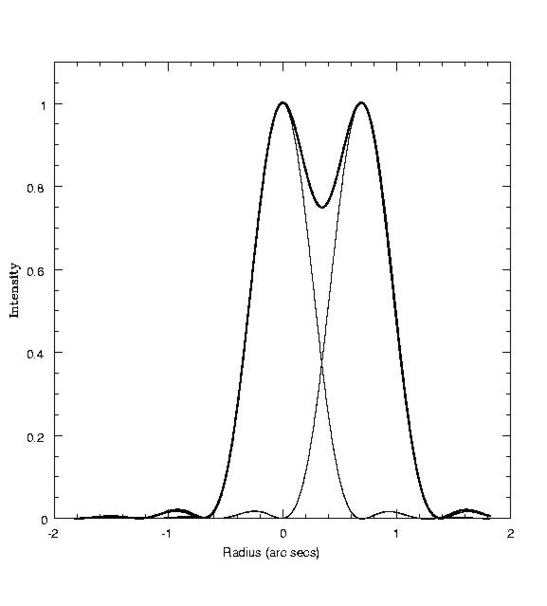
Rayleigh limit

Slide 18
Dawes limit (empirical)
Usually defined as 4”.56/d(in)
Diameter Resolution
(cm) (arc secs)
10 1.16
20 0.58
30 0.39
40 0.29
100 0.12

Slide 19
Practical limits of resolution
Lewis found:
Equal bright pairs (5.7, 6.4) 4”.8/d
Equal faint pairs (8.5, 9.1) 8”.5/d
Unequal pairs (6.2, 9.5) 16”.5/d
Very unequal pairs (4.7, 10.4 36”.0/d
But Aitken found for
Equal bright pairs (6.9, 7.1) 4”.3/d
Equal faint pairs (8.8, 9.0) 6”.1/d

Slide 20
Improvement in resolution
Separation Period
Almagest (140AD) 11 arc mins
First telescopic pair (1617) 15 arc secs 15000 years
Herschel (1800) 0.5 arc sec 50 years
Burnham and Aitken (1900) 0.1 arc sec 5 years
Michelson (1920’s) 0.05 arc sec 100 days
McAlister (speckle) 0.03 arc sec
Ground-based arrays
NPOI 0.004 arc sec 4 days
SUSI 0.00005 arc sec hours

Slide 21
The telescope moves on
Dawes offered the telescope to Cambridge Observatory in 1867 for £580
J. C. Adams considered it the equal of Struve’s 9.3-inch at Dorpat
The University Regents decided not to proceed with the purchase
It was then sold to George Hunt who used it infrequently – on his death it passed to W H Maw

Slide 22
George Hunt FRAS (1823 - 1896)
Family involved in ironworks and collieries
Bought the telescope in 1869 and erected it in Edgbaston, later moving to Dulwich
Wrote more than 20 papers on a range of topics
Between 1869 and 1894

Slide 23
William Henry Maw (1838 - 1924)
Started work as draughtsman in railway office
Rose to become head of the office then a consulting engineer
Founder and editor of the journal Engineering for 60 years
Honorary degree (LL.D) from Glasgow
Bought telescope from George Hunt in 1896
Published 731 mean measures in 5 papers in MNRAS

Slide 24
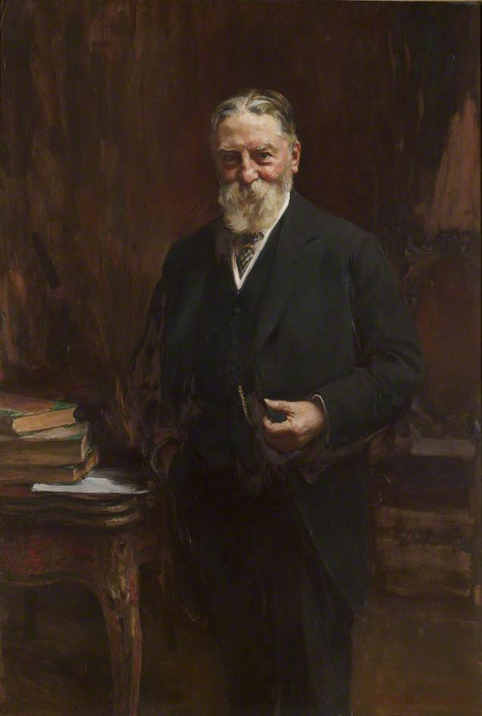

Slide 25
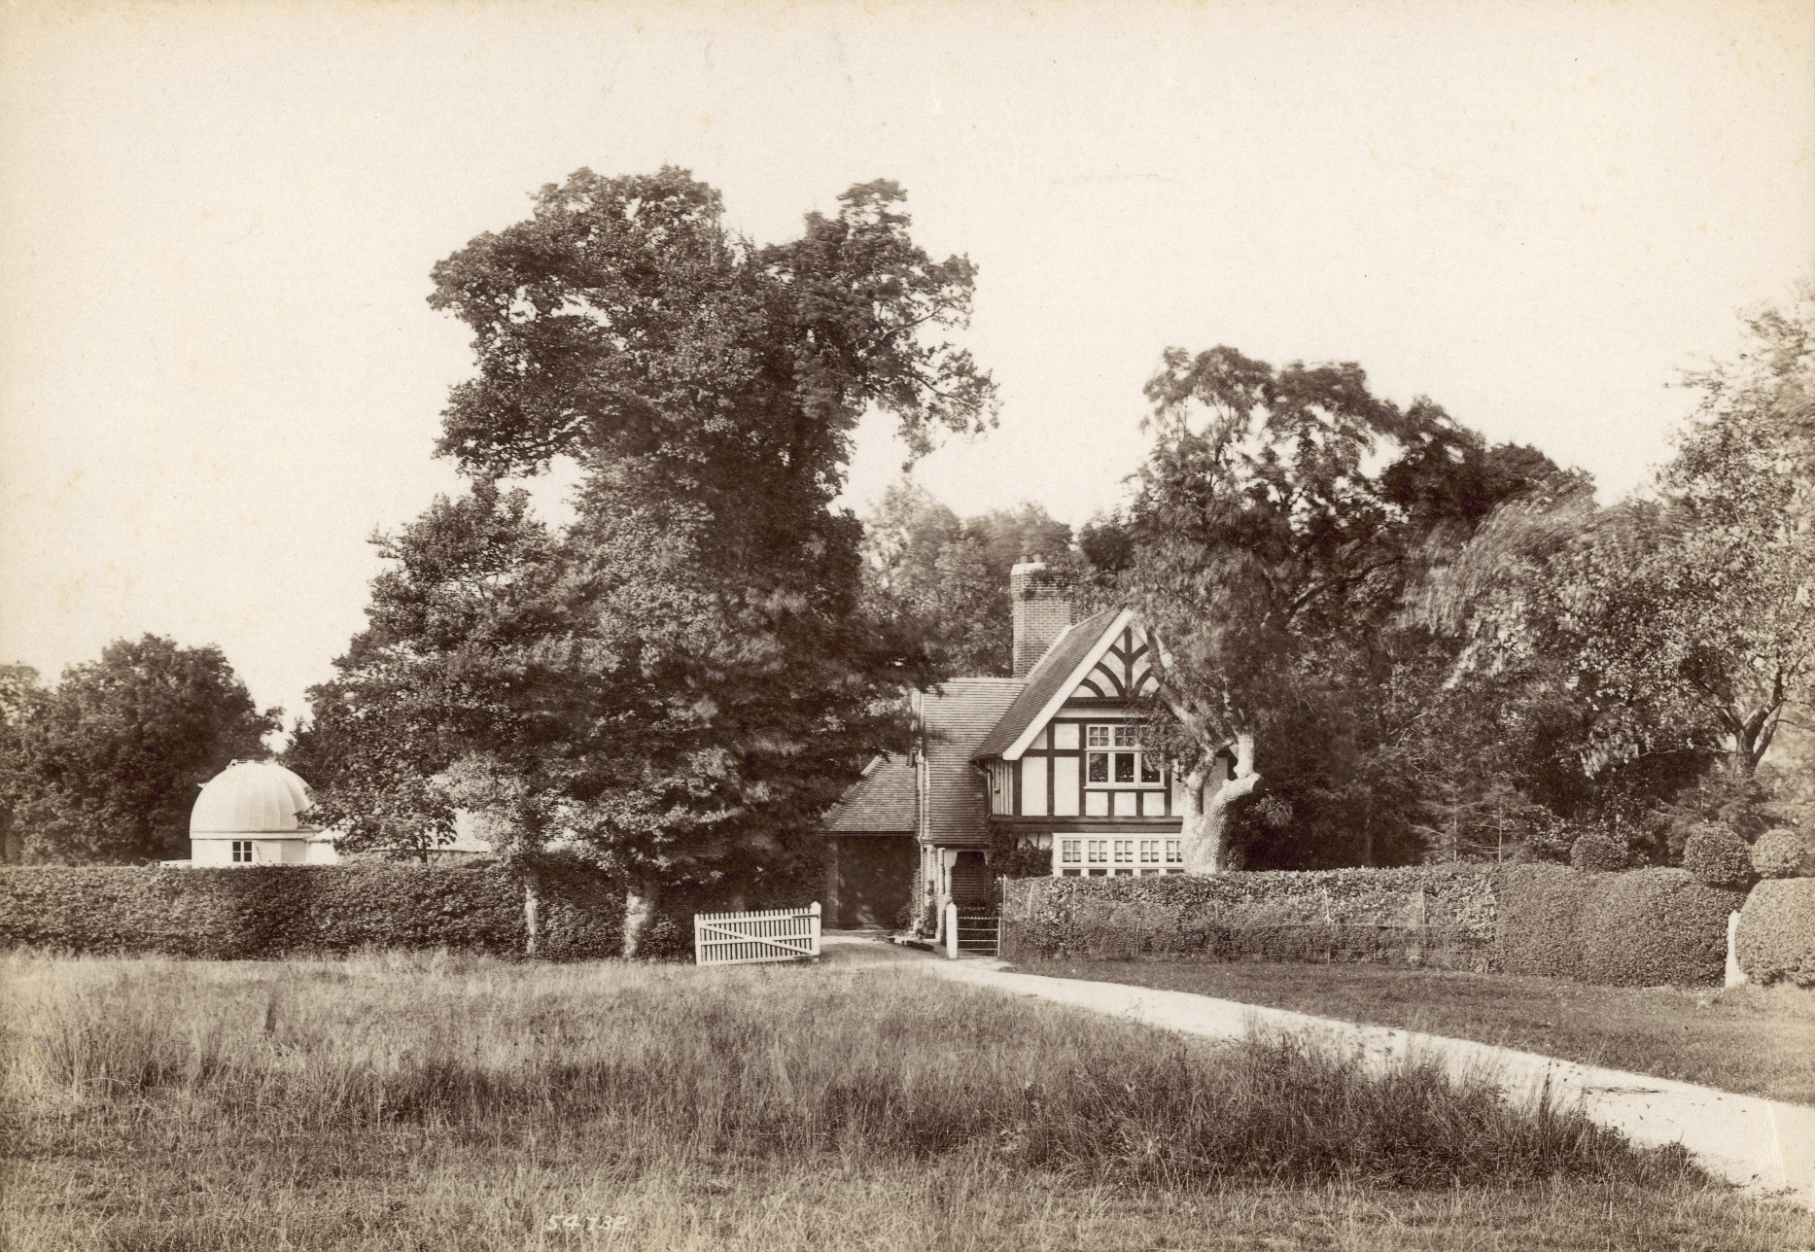
Maw’s house Outwood, Surrey

Slide 26
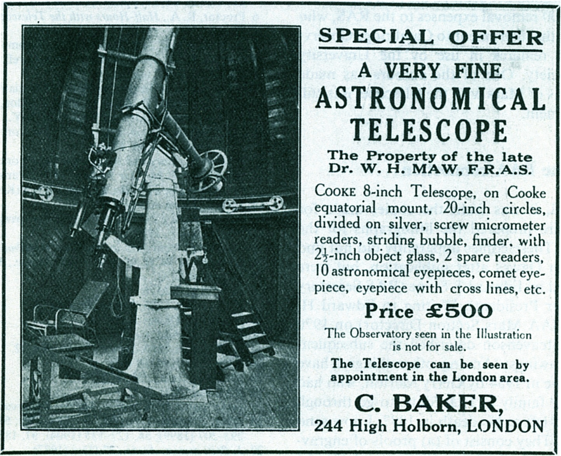

Slide 27
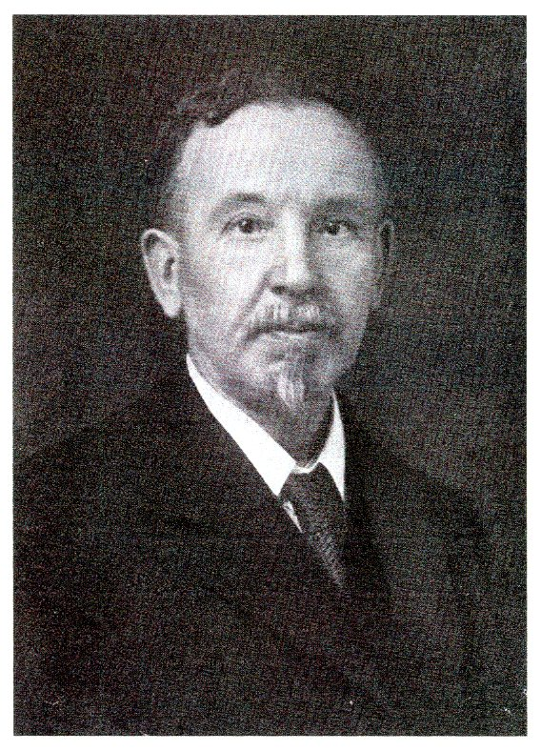
W. J. Thorrowgood FRAS

Slide 28
William John Thorrowgood (1862 – 1928)
Signals Engineer on Southern Railway
Bought the telescope in 1927 and installed it in his garden at Wimbledon, London
Died in 1928 and left the telescope and dome to the RAS
On loan to Cambridge in 1929

Slide 29
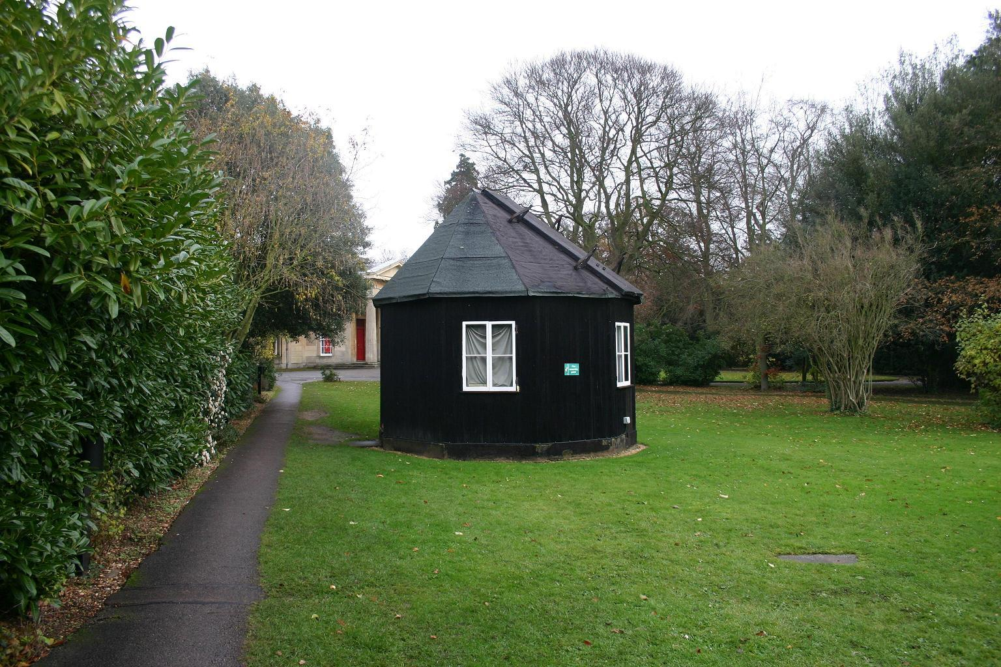
Coming to Cambridge
Thorrowgood’s dome is till in use 89 years on

Slide 30
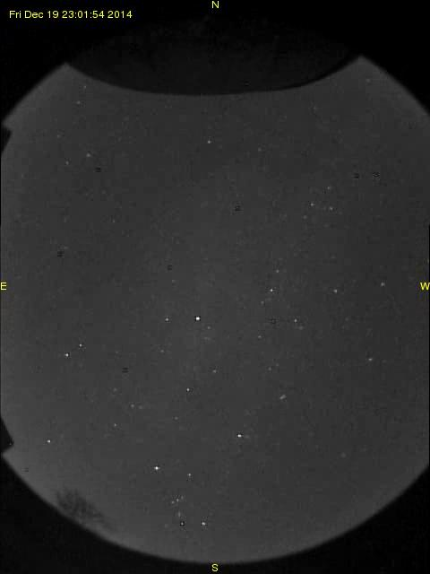

Slide 31
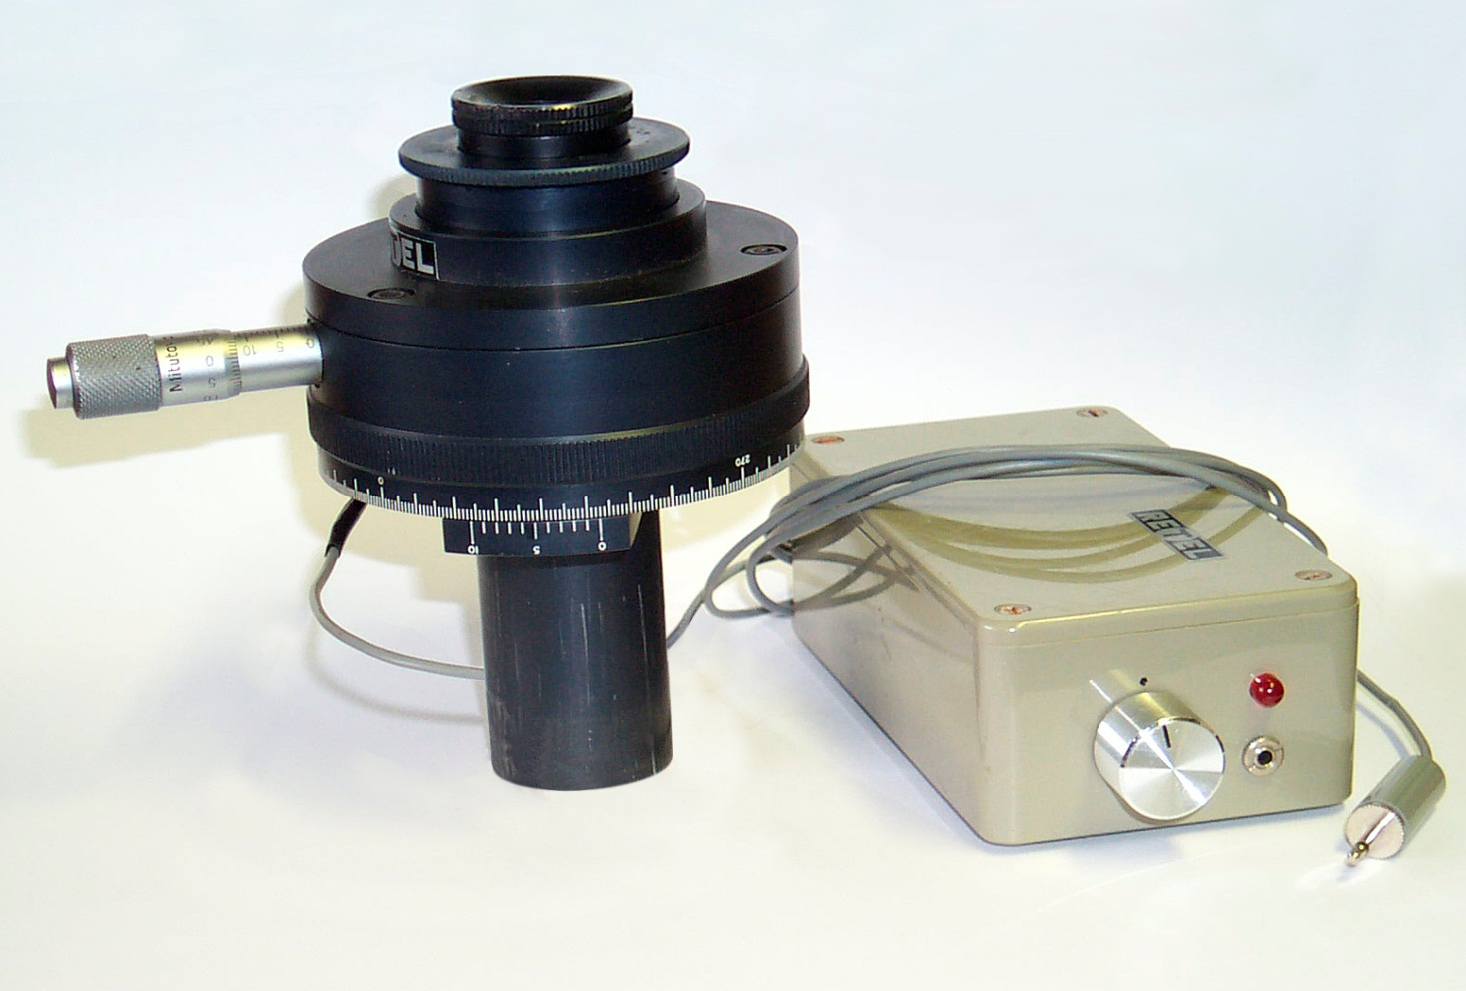
RETEL micrometer - 1

Slide 32
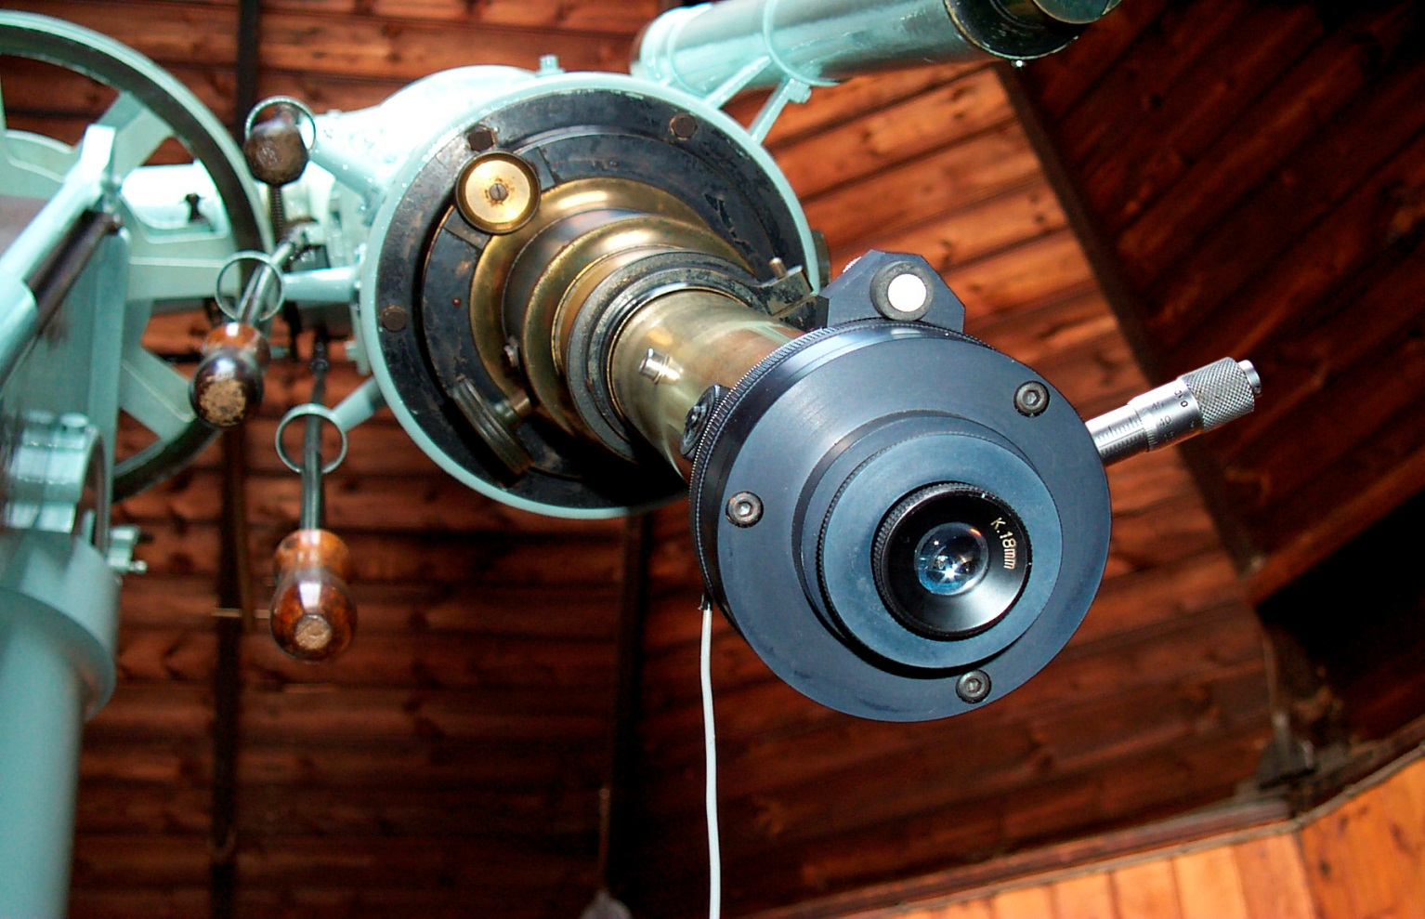
RETEL micrometer – 2 Fitted to the 8-inch Cooke refractor at Cambridge.

Slide 33
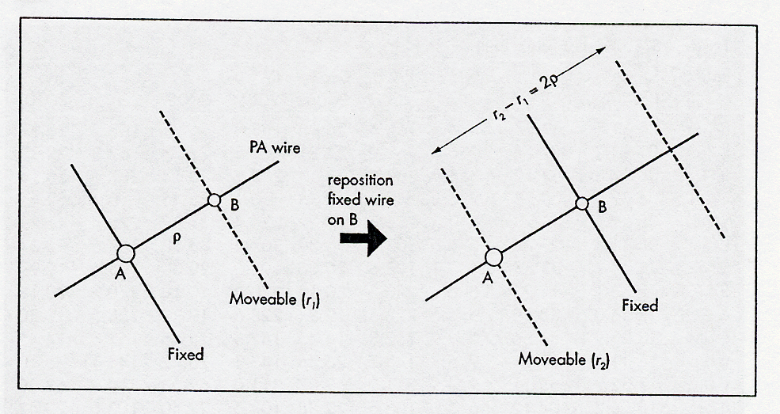
Filar micrometer - measurement technique
First setting Second setting

Slide 34
Cambridge -1
Started 1990 March using a RETEL micrometer
X2.9 Barlow + 18 mm Kellner = x460
12 micron wires subtend 0”.3
Scale = 12”.46 per revolution = 24”.93 per mm
Range of measurement: 0”.4 to 155”
Bright field illumination (red LED)
Magnitude limit: V ~ 10
Dec limit: -20 degrees

Slide 35
Cambridge - 2
840 nights
9,250 individual measures
2,450 means
1,680 measures of calibration pairs
12 micrometer settings per measure –
4 double distance + 4 angles
(Calibrations: 6 double-distance and 6 angles at beginning
and end of night)

Slide 36
Cambridge - 3
Calibration pairs from Hipparcos catalogue
RA Dec n scale (“) error(“)
iota Cnc (30”) 0847 +2846 160 24.86 0.14
delta Ori (52”) 0532 -0018 140 24.96 0.12
delta Boo (108”) 1526 +3319 120 25.02 0.10
theta Ser (22”) 1856 +0812 44 24.82 0.13
beta Cyg (34”) 1931 +2758 230 24.94 0.12
alpha CVn (19”) 1256 +3819 116 24.92 0.16
nu Dra (62”) 1732 +5511 50 24.97 0.11
16 Cyg (39”) 1850 +3322 85 24.90 0.12
Weighted mean = 24”.93

Slide 37
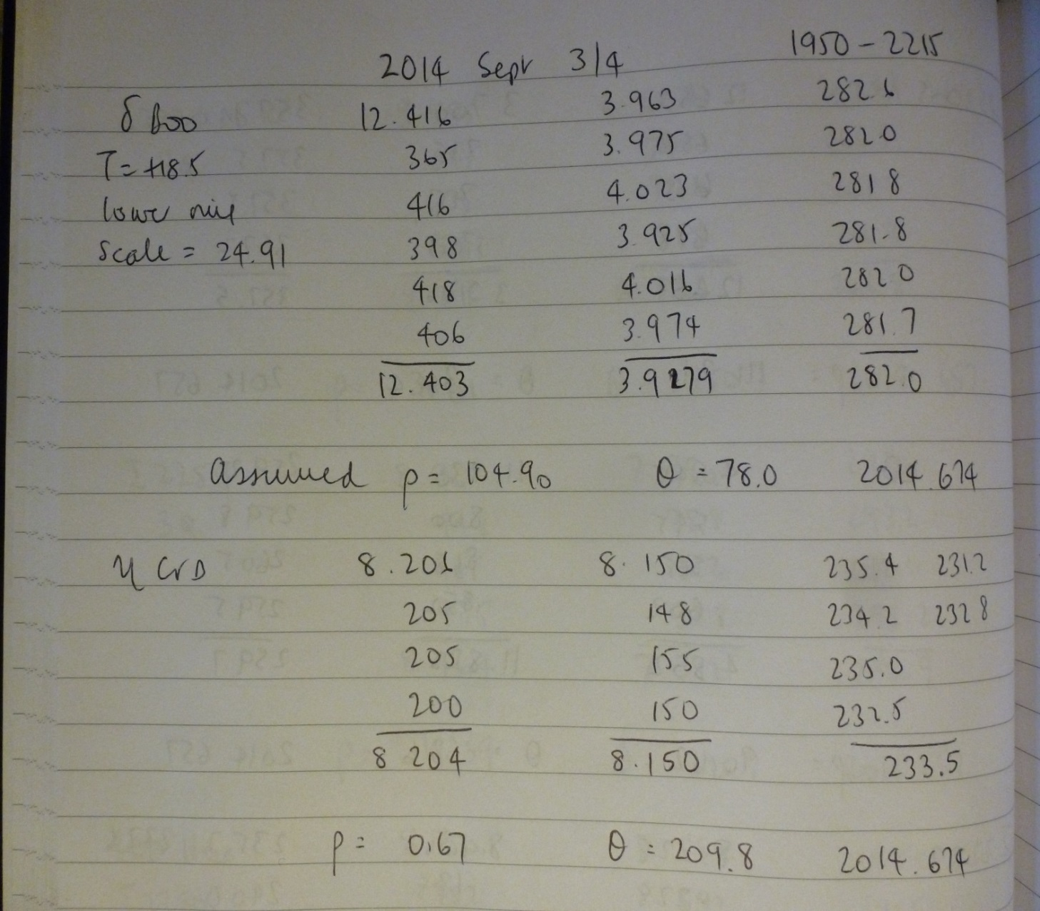
Observing log

Slide 38
Assessment of measurement accuracy
Compared 1242 mean measures with published astrometry from Hipparcos and speckle
No corrections made for orbital motion –choose similar epochs
Hipparcos and Tycho catalogues (>10”)
USNO speckle : 67-cm
Mason & Hartkopf : 4-metre KP and CT
Tokovinin: 4.2-metre SOAR
Horch: 3.5-metre WIYN
Scardia and Prieur: 1-metre and PISCO camera
Losse – 40-cm

Slide 39
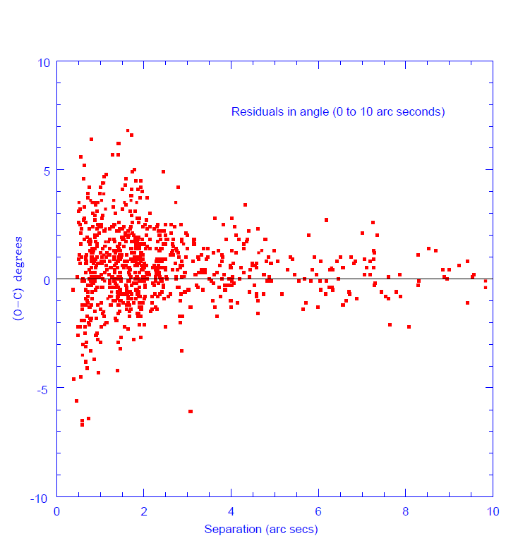
N = 832

Slide 40
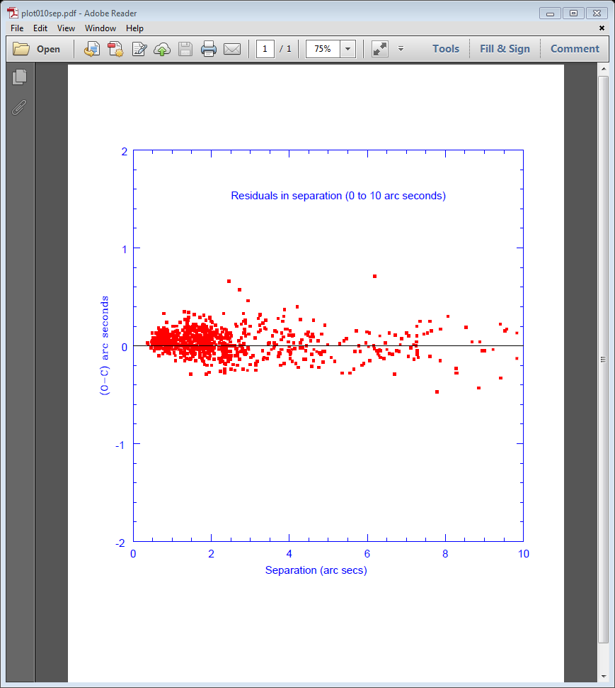
N = 832

Slide 41
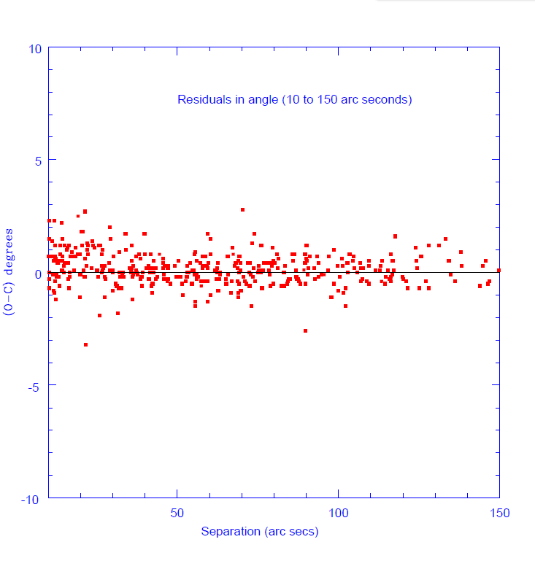
N = 410

Slide 42
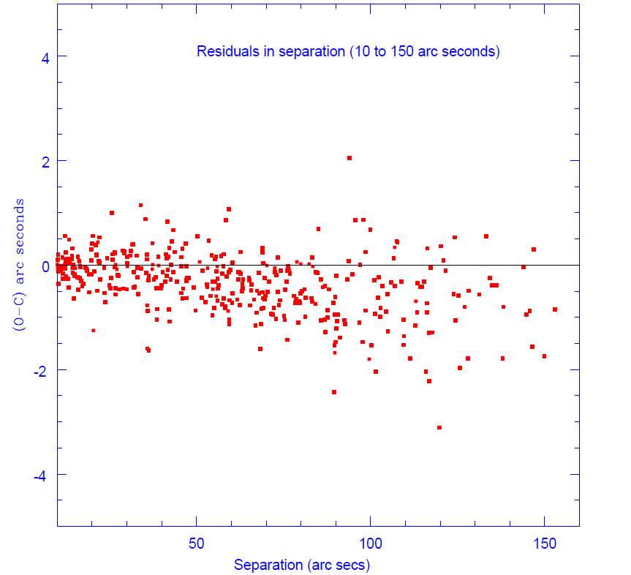
N = 410

Slide 43
Samples of binary systems followed
Means taken annually:
STF1110, 1196, 1523, 1536, 1670, 1888, 1909, 1937, 2055,
2084, 2130, 2272, 2758, SHJ345, STF2909, 3050
Every 2 – 3 years
STF73, 202, STT98, STF1037, 1273, 1356, 1865, 1938, 2032,
2052, 2382, 2383, 2579, STT 413, STF2737, 2822, 3062
Every 4 to 5 years
STF 60, 208, 554, 728, STT 545, STF1338, 2262, STT 358,
STF2944

Slide 44
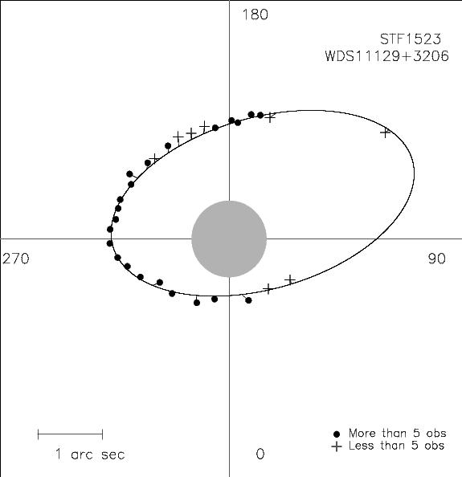
Xi UMa P = 59.8 years

Slide 45
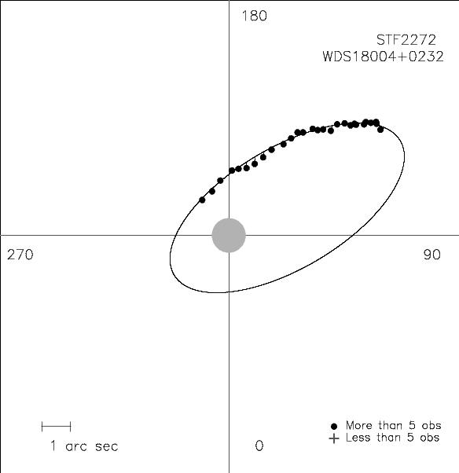
70 Ophiuchi P = 88.3 years

Slide 46
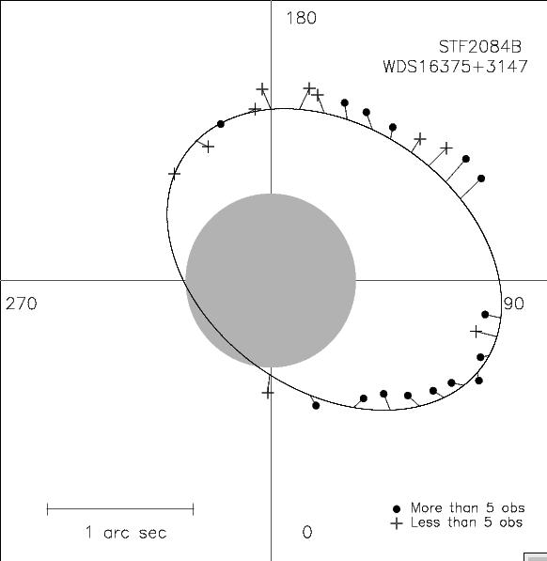
Zeta Herculis P = 34 years

Slide 47
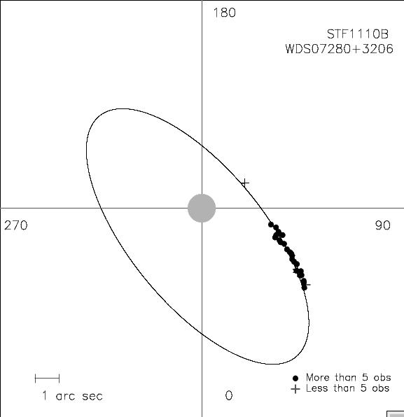
Castor P = 466 years

Slide 48
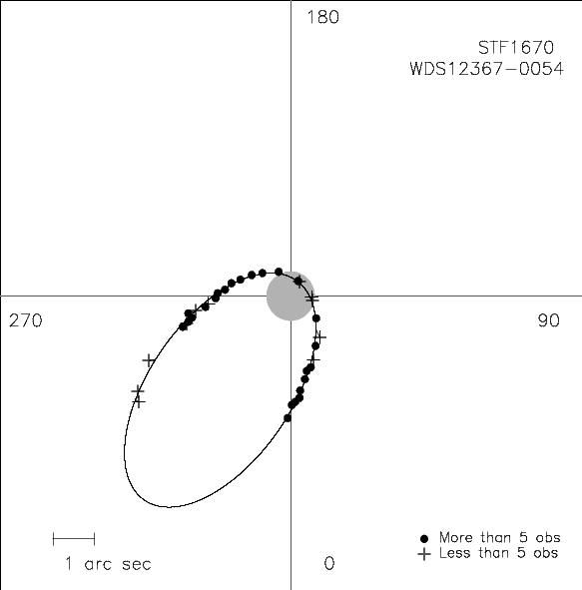
Gamma Vir P =169.104 years

Slide 49
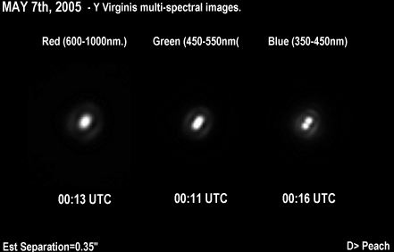
Gamma Virginis imaged in 2005 by Damian Peach

Slide 50
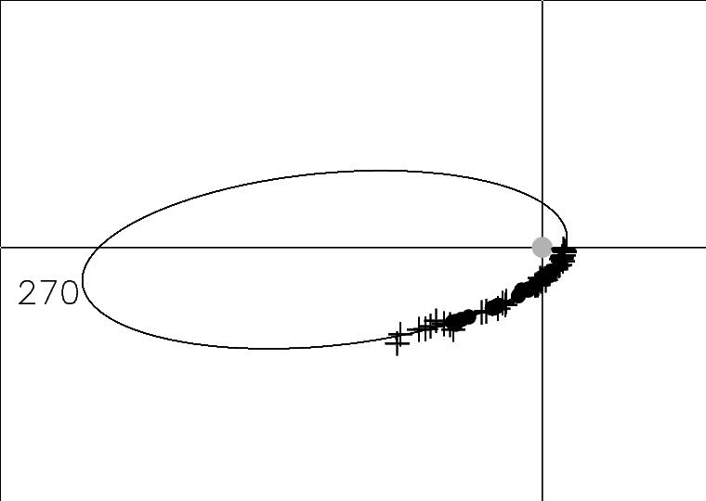
53 Aqr P = 3500 years (?)

Slide 51
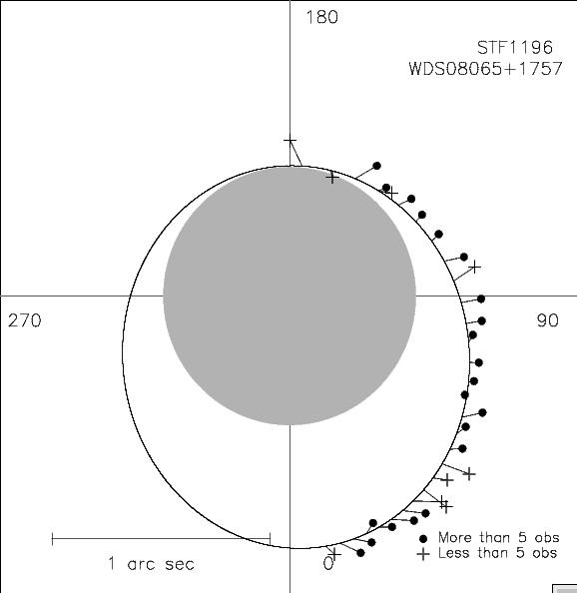
STF 1196 (zet Cnc AB) P =59.8 years

Slide 52
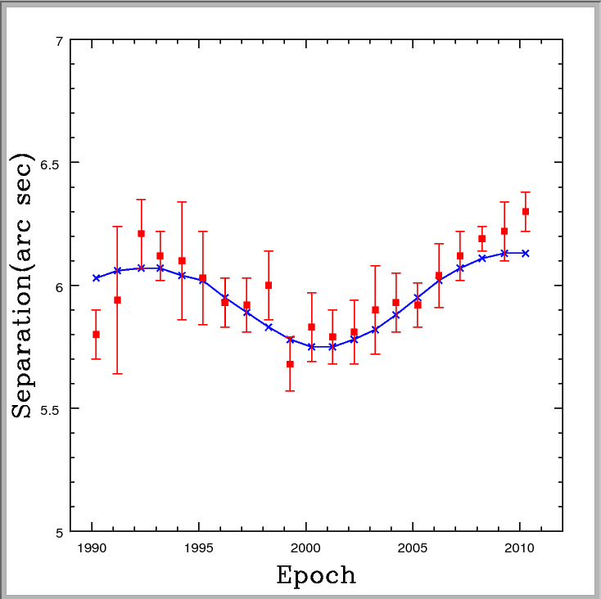
Measures of separation in zeta CnC AB-C over 20 years showing perturbation due to Cc

Slide 53
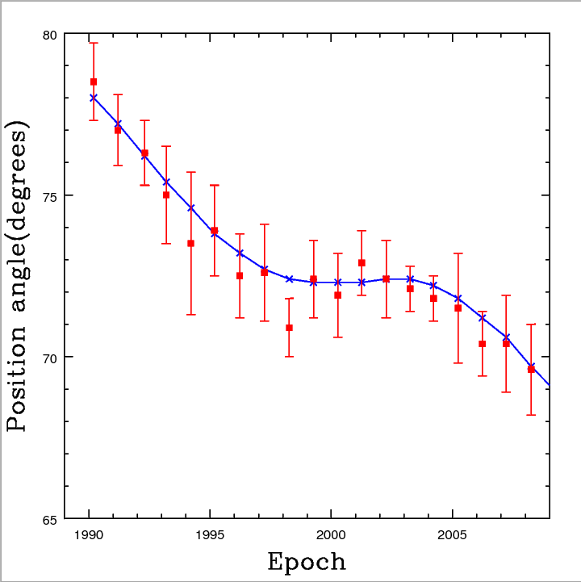
Measures of position angle of zeta Cnc AB-C showing perturbation of AB by Cc

Slide 54
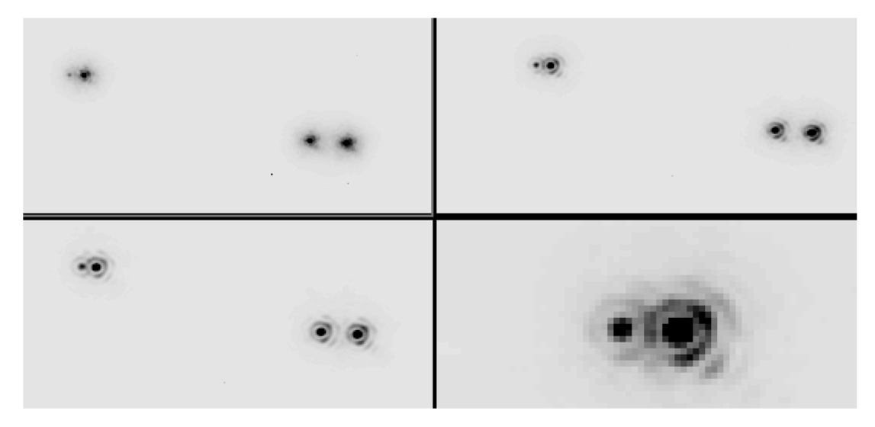
Zeta Cancri quadruple system

Slide 55
Publication of observations
The measures from the 8-inch programme have been published in the Circulars of the Webb Society Double Star Section Nos 5 to 26 and are freely available on:
www.webbsociety.org/double-stars/double-star-section-circulars

Slide 56
Amateur double star groups
Webb Society Double Star Section Circulars (UK) - annual
Started 1979 – 26 editions – 1650 pages
Journal of Double Star Observations (USA) - quarterly
Founded 2005 - 53 editions - 4250 pages
El Observador de Estrellas Dobles (Spain) - quarterly
Founded 2009 - 21 editions - 1950 pages
Il Bolettino delle Stelle Doppie (Italy) - quarterly
Founded 2012 - 26 editions - 1165 pages
Societe Astronomique de France Double Star Section
Founded 1981 – published in Observations y Travaux

Slide 57
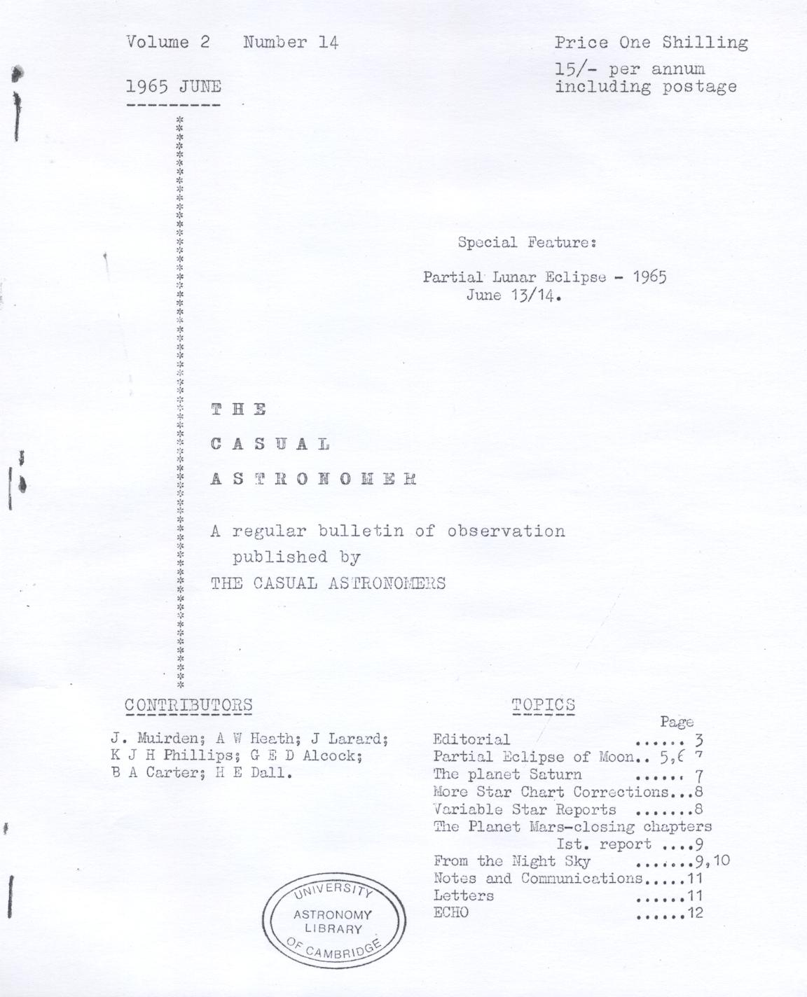
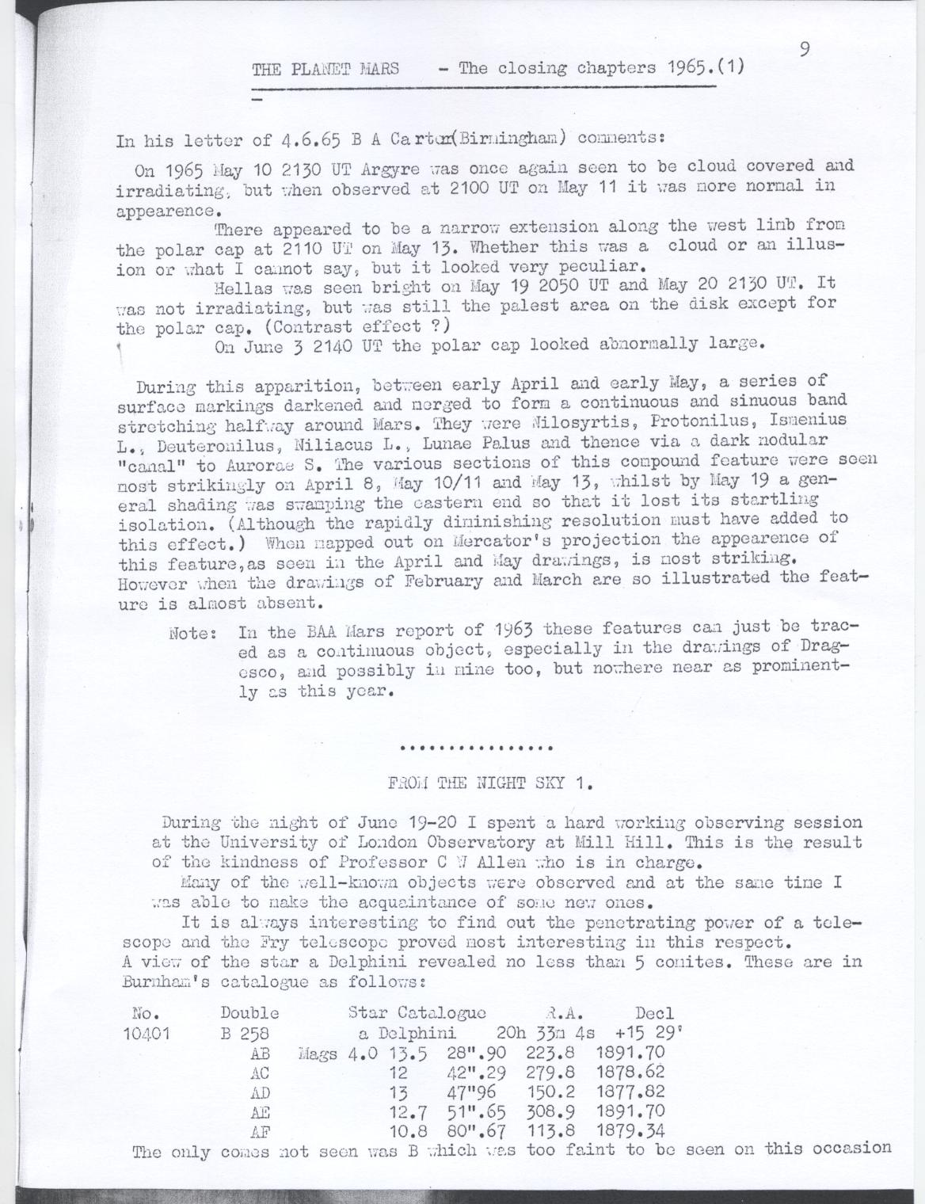
From the Night Sky – John Larard

Slide 58
Webb Society Double Star Section
Formed 1968
Double Star Handbook published 1975
Measurement started 1979
Circulars began 1979
Current issue No 26 (2018 – in prep.)
Measures to date: 51,000+

Slide 59
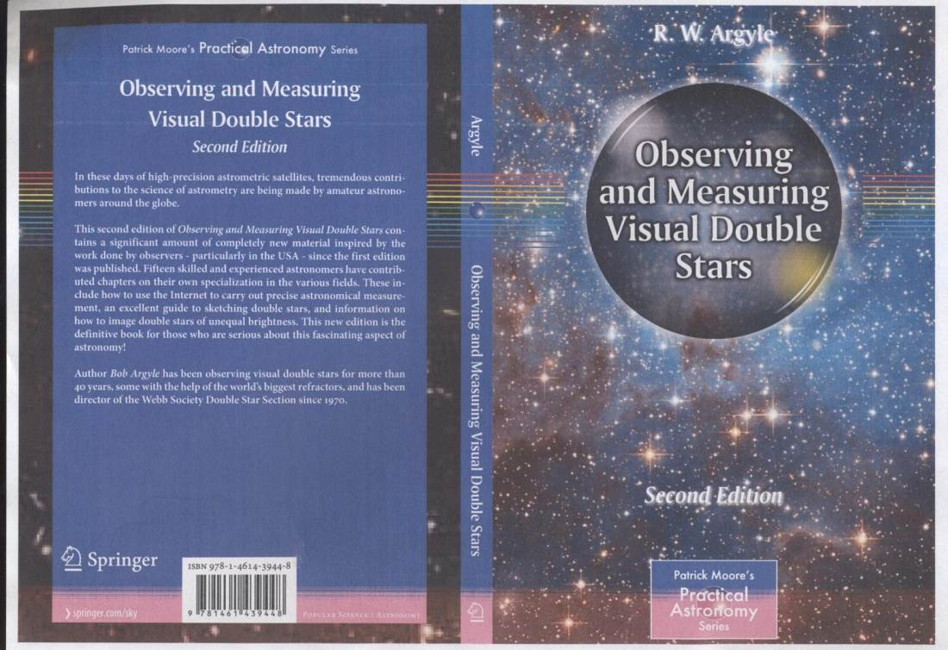

Slide 60
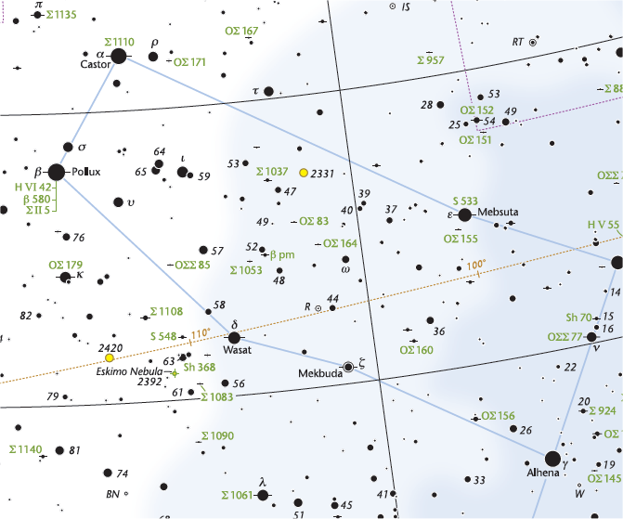
Cambridge Double Star Atlas 2

Slide 61
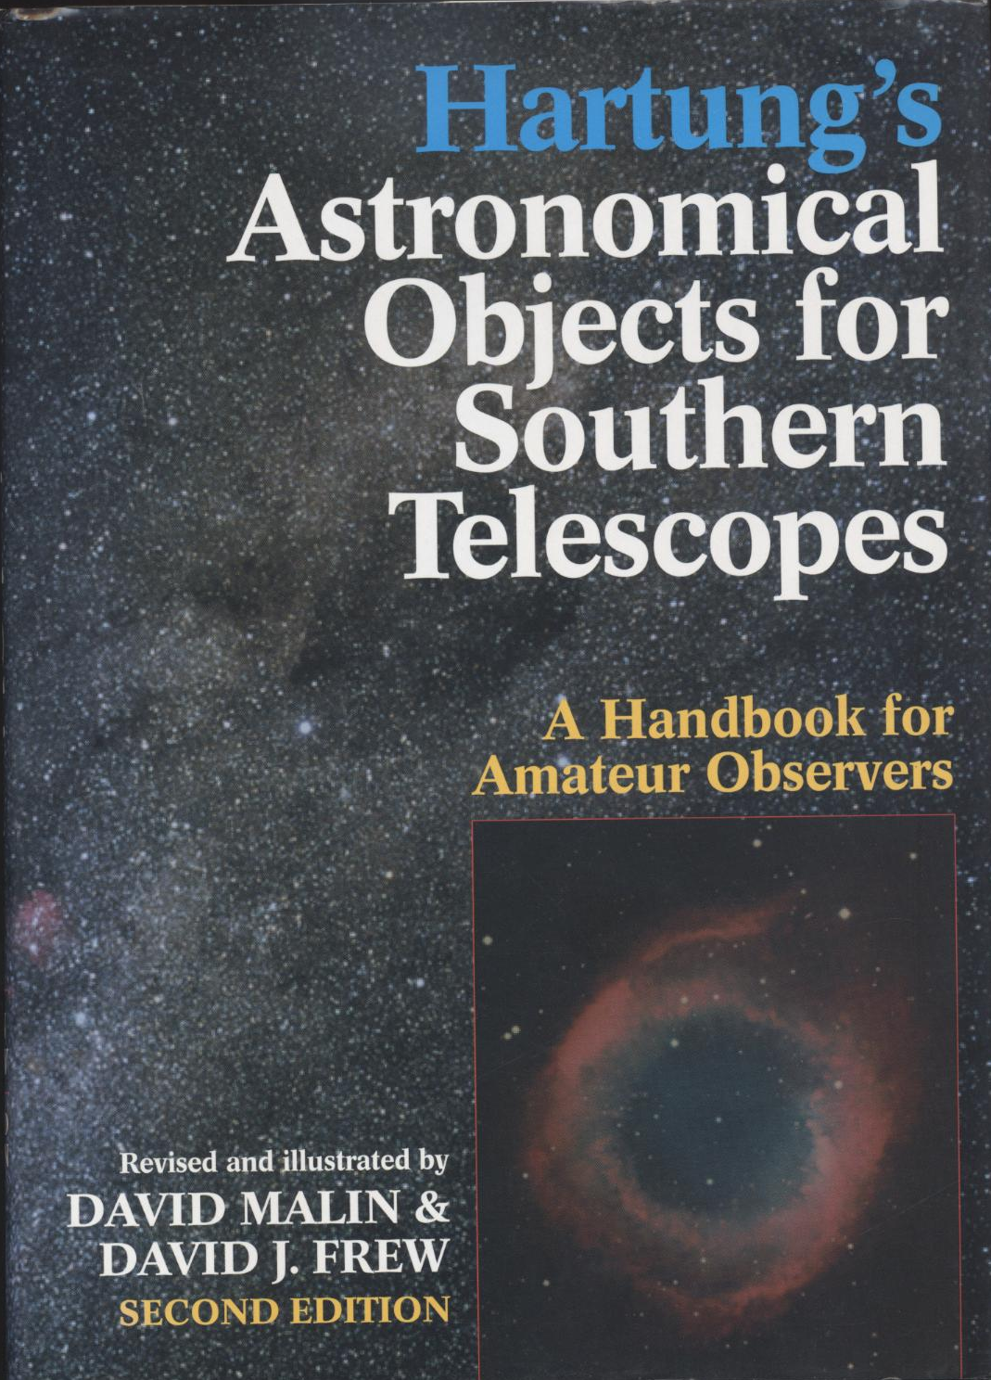
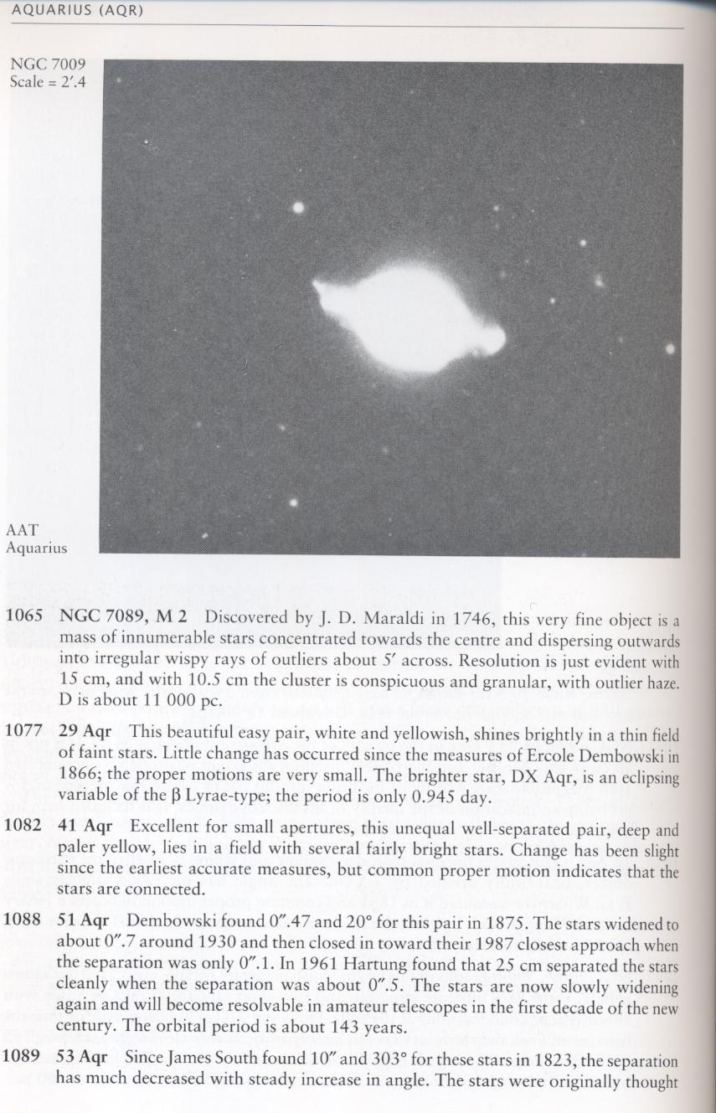
Hartung

Slide 62
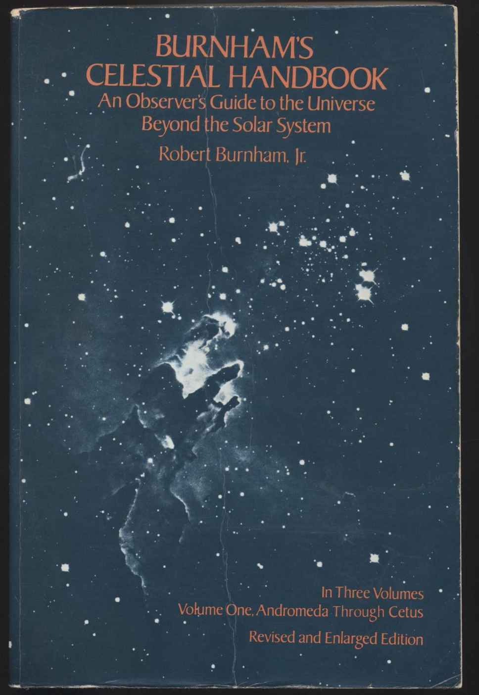
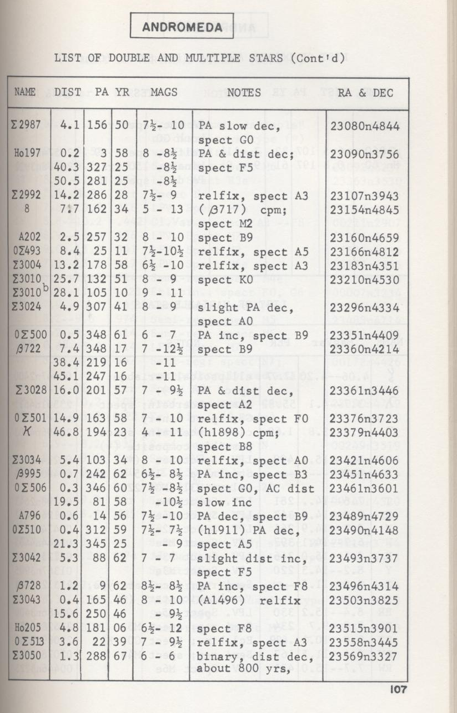
Burnham’s Celestial Handbook (3 vols)

Slide 63
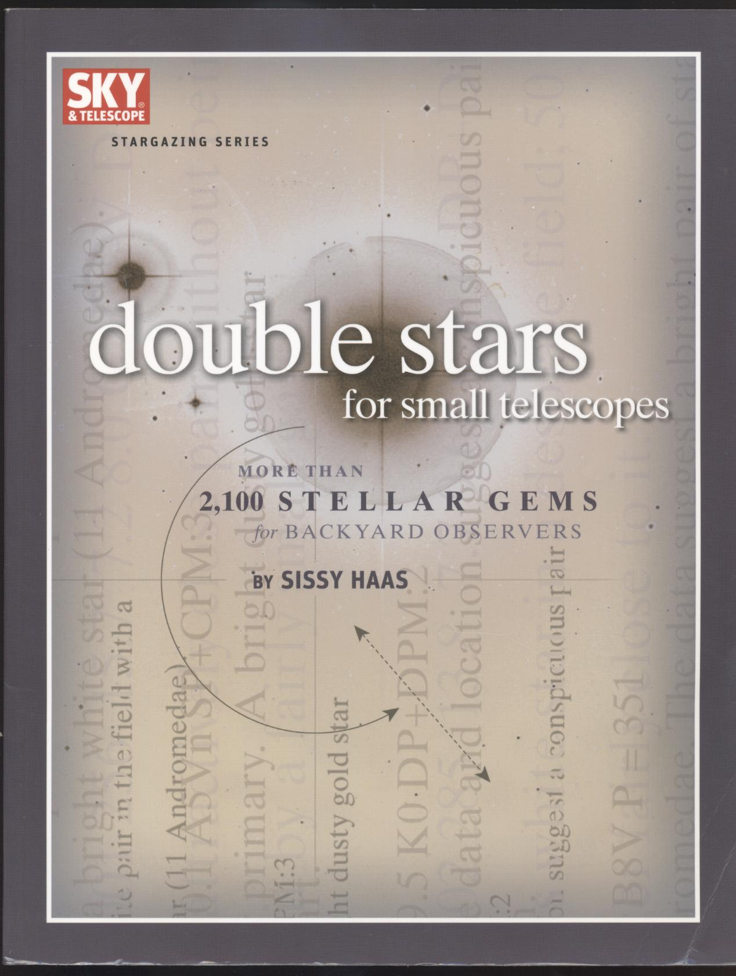
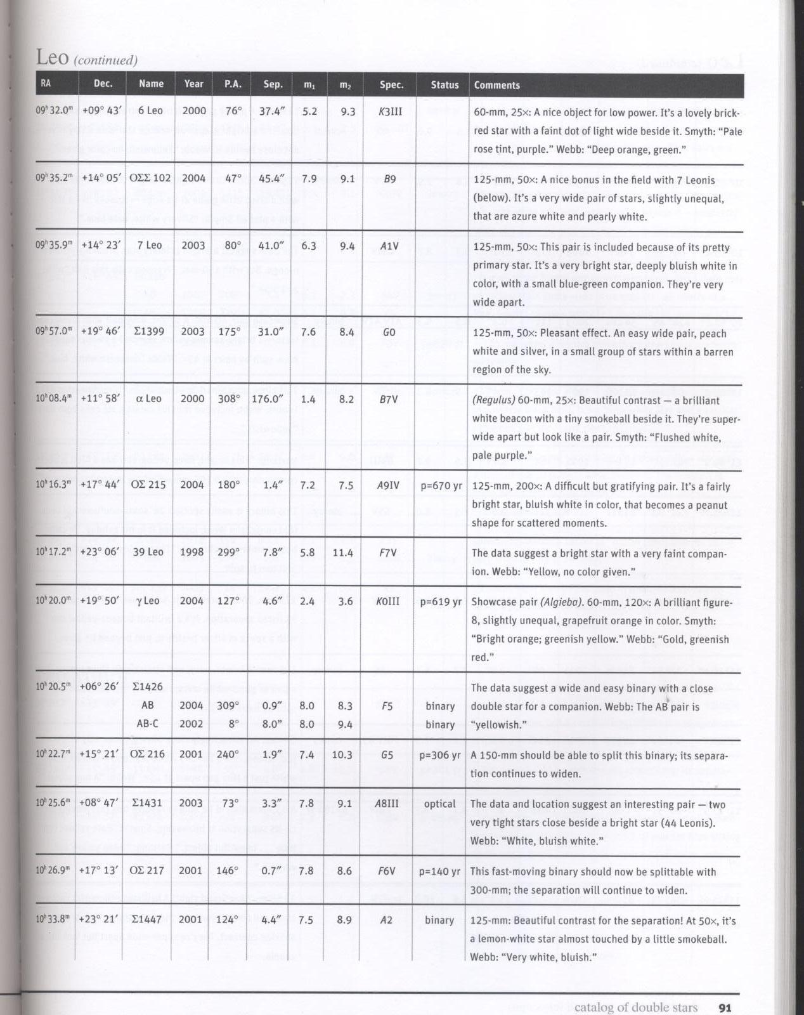
Haas

Slide 64
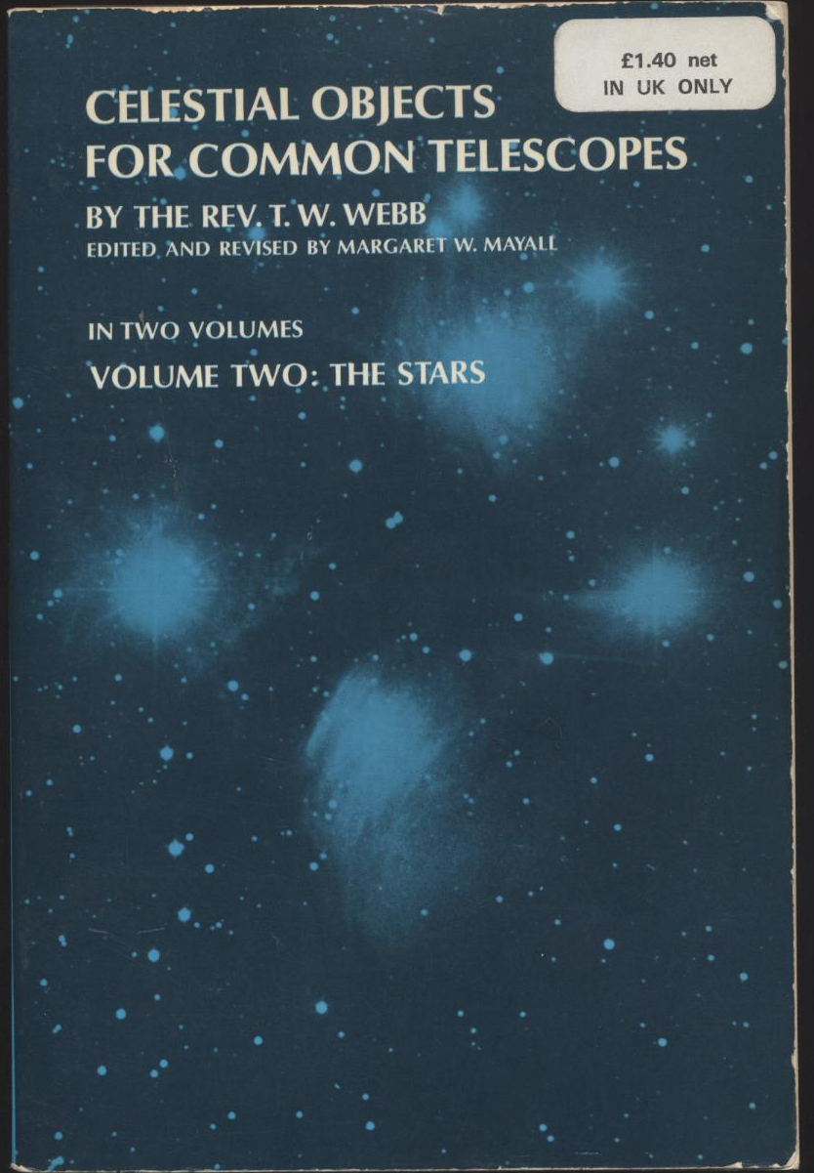
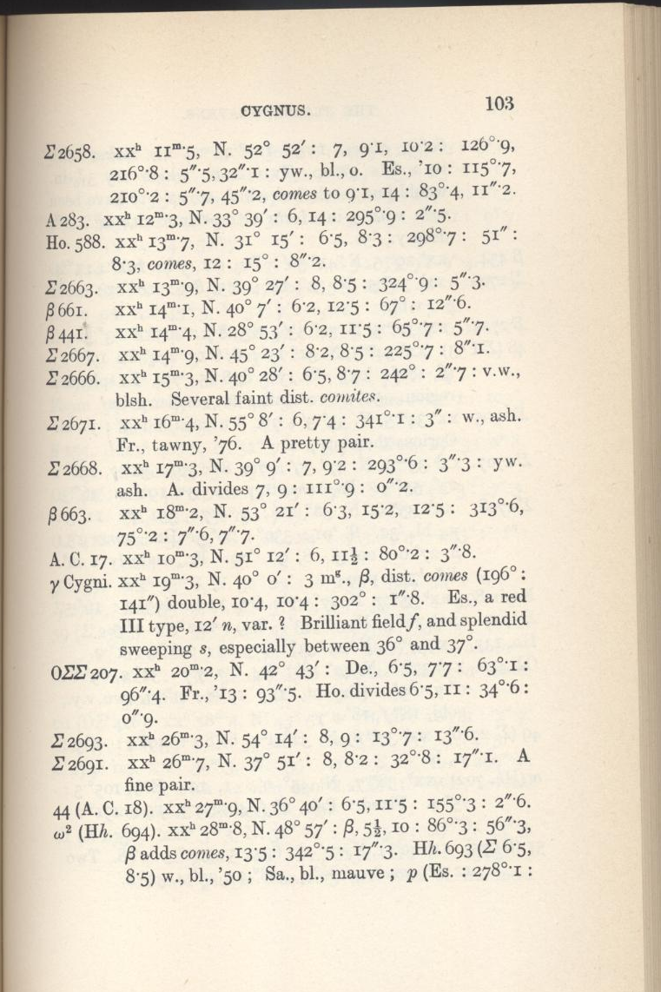
Webb

Slide 65


Slide 66


Slide 67
USNO 6th orbital catalogue
Grade | Category | Longest period (years) | Pairs | %
1 | Definitive | 88.38 | 52 | 3.6
2 | Good | 257 | 198 | 13.8
3 | Reliable | 522.16 | 292 | 20.4
4 | Preliminary | 18212.2 | 454 | 31.7
5 | Indeterminate | 32000 | 437 | 30.4

Slide 68


Slide 69

THE END

Slide 70

Another Thorrowgood telescope

